Slide 1



The Right Price
Galvanize 2021
Lauren Schoener
Notes:
Hi, my name is Lauren Schoener and I am presenting The Right Price. I, like many others, am interested in one day owning a vacation home and renting it out through Airbnb.

Slide 2
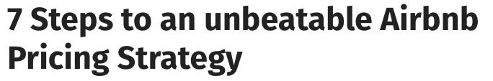
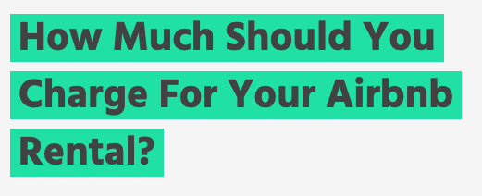
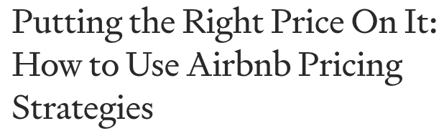

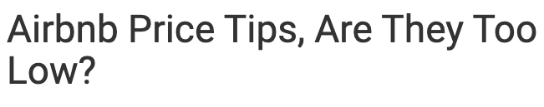




How can Airbnb hosts set the best price?
Notes:
A quick search on how to price a listing brings up a large amount of websites with very subjective advice. I wanted to build an Airbnb price recommender based on property features. I chose to use London listing data but the results can be applied to any market.

Slide 3

Who is the end user?
Notes:
My target audience is new Airbnb hosts who either already own property or are looking for places to purchase a property.

Slide 4



Approach and Technologies
Retrieve Data from API
Data Cleaning
Feature Importance
Build Model
Hyperparameter Tuning
Recommendations
Notes:
My approach to building the recommender was to start by getting my data using an API called Inside Airbnb, clean my dataframe, look at the feature importance, build and tune my model, and to be able to use the model to make recommendations.

Slide 5
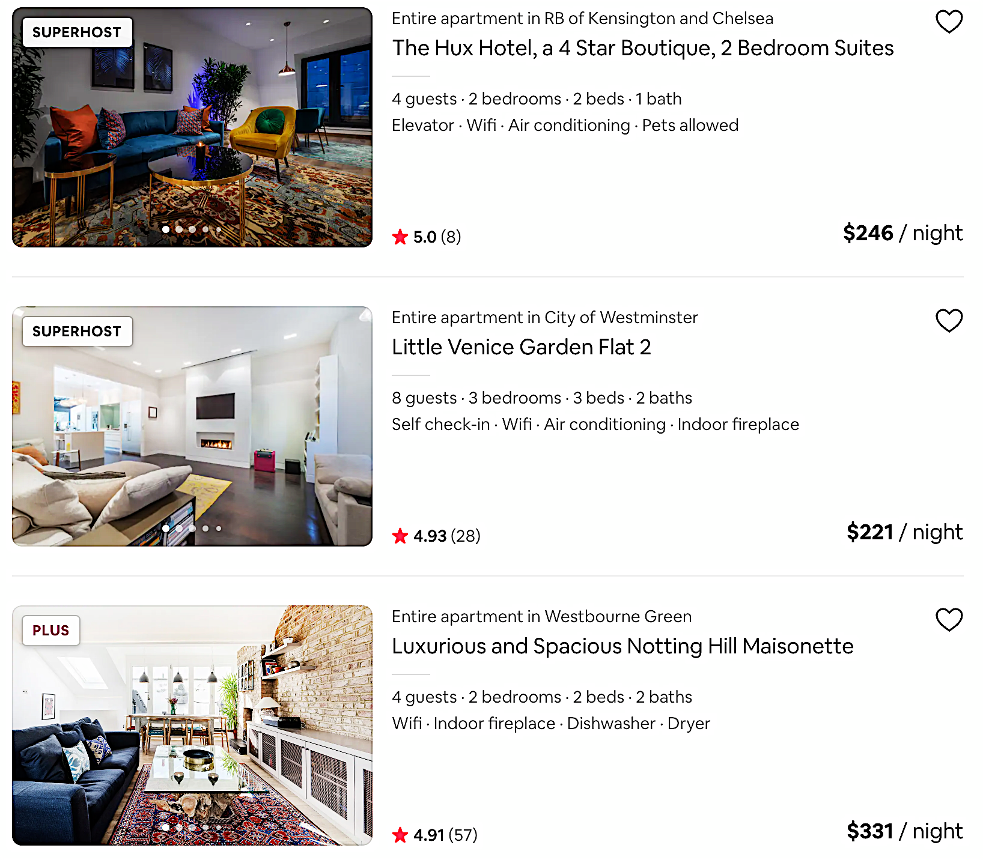
The Data
76,984 listings
73 features
33 boroughs
Notes:
Inside Airbnb used a London Airbnb dataset of almost 77,000 listings, categorized by 73 features over 33 London boroughs.

Slide 6
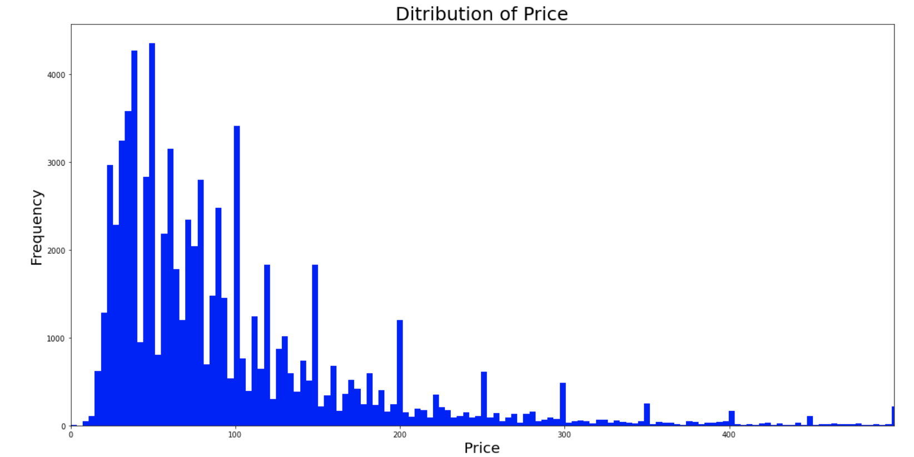
Summarizing Price
Mean: $112.107
Std: $325.92
Min: $0.00
25%: $43.00
50%: $75.00
75%: $121.00
Max: $18,673.00
98.4% of the price data is below $500
Notes:
Looking at the distribution of price, I noticed that although I had several very large listings with a max value of over $18,000, 98.4% of my data was below $500, and since I wanted my model to target the majority of hosts, I chose to eliminate the listings that were greater than $500.

Slide 7
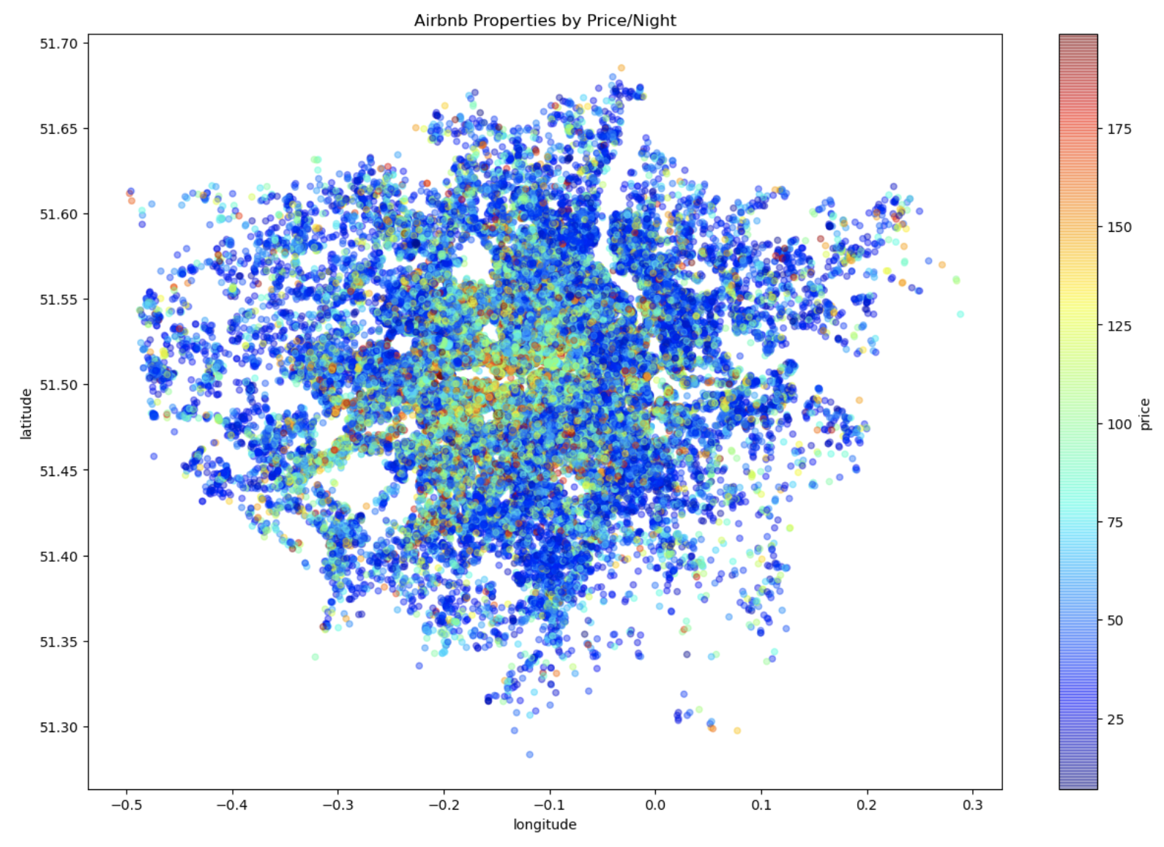
Geographical Price Distribution
Notes:
I graphed the price distribution geographically using the lat/long data and the plot showed a trend of more highly priced homes around the Thames River, indicating that the name of the borough may influence price.

Slide 8
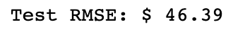
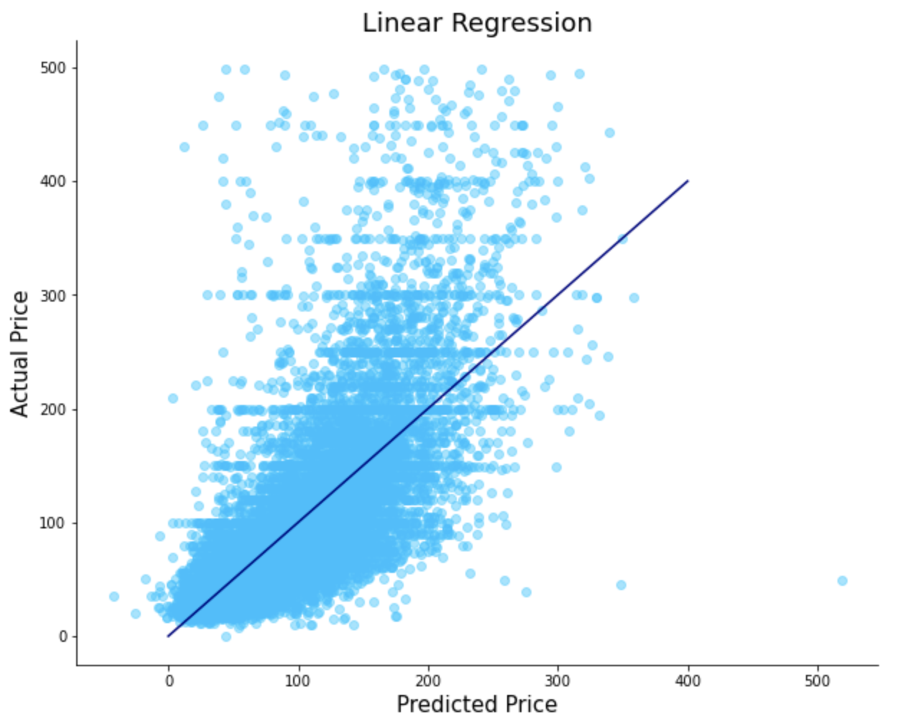
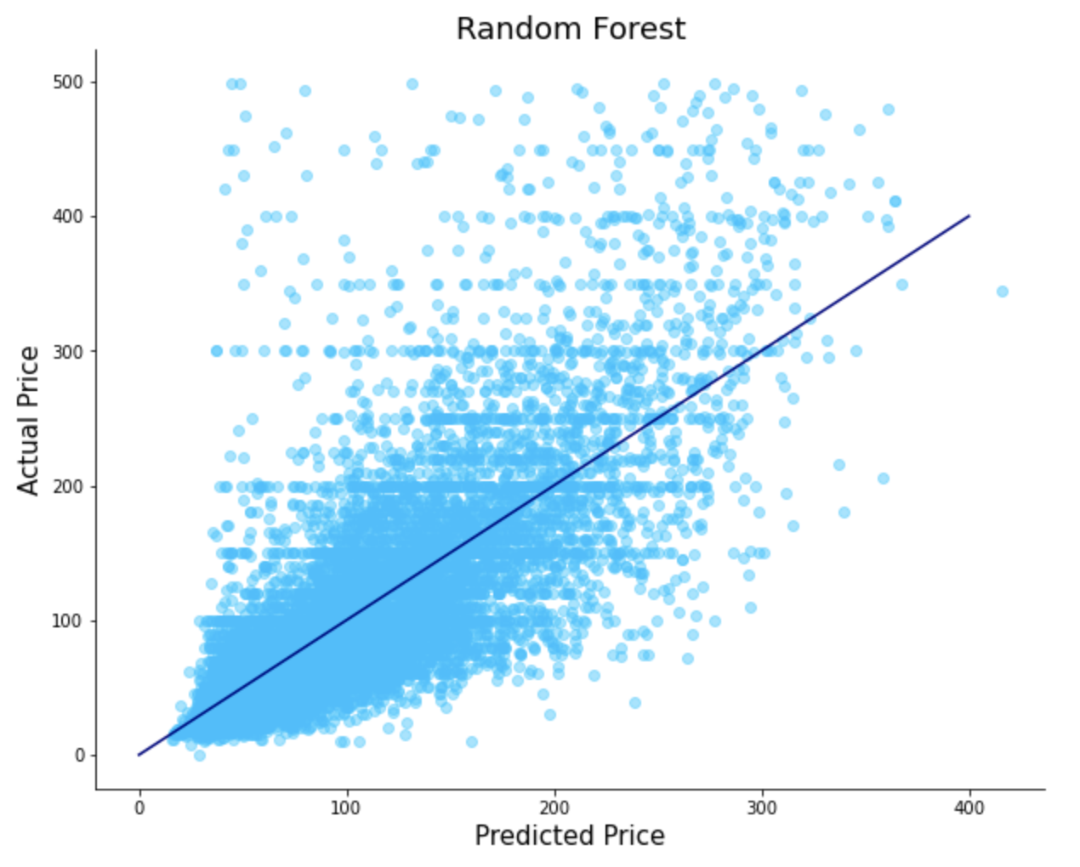
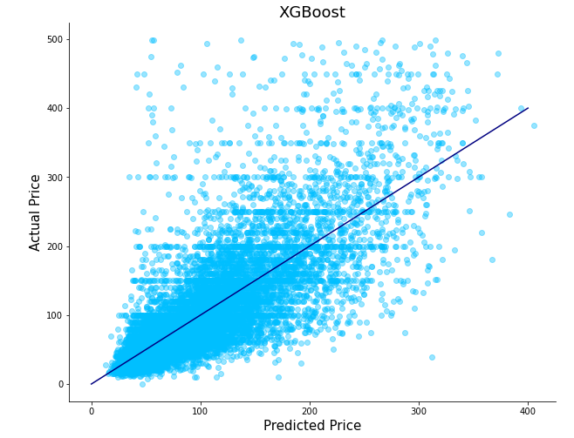
Training the Models
Notes:
I built three different models using Linear Regression, Random Forest and XGBoost. My Linear Regression model performed the worst with a Root Mean Squared Error of $52.21 and my Random Forest and XGBoost model performed a little better at $46.39 and $46.66. I plotted each model’s predicted price versus the actual price for the listing. The plot for the linear regression model suggests that as price increases it may perform significantly worse than the other two models. Even though my XGBoost model did slightly worse than my Random Forest model, I believe if I had more time to run it through the Grid Search then it would have out performed my Random Forest model.

Slide 9
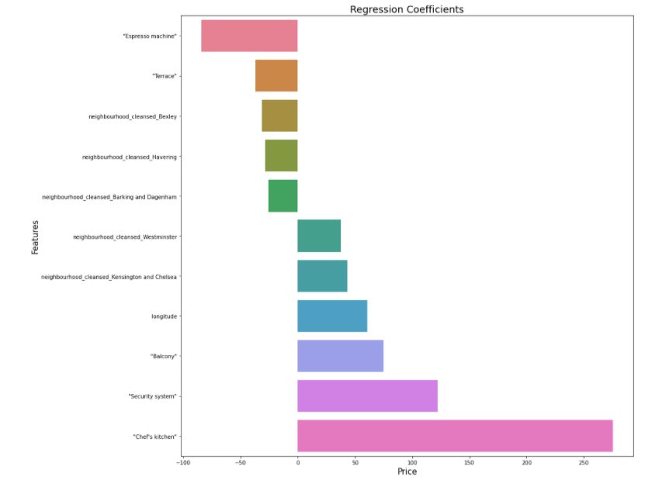
Feature Importance
Notes:
I found each feature importance to price and plotted a few of the most extreme to get a sense what I could recommend to the hosts.

Slide 10
Recommendations
Amenities:
Security System
Air Conditioning
Dishwasher
TV
Neighborhoods:
Kensington and Chelsea
Westminster
Richmond upon Thames
City of London
Notes:
Amenities that could be relatively easily added to potentially increase the price of a property are Security system, air conditioning, a dishwasher and TV.
For new hosts, the importance of living in particular boroughs could be beneficial to increasing price, keeping in mind housing market. A few boroughs with higher feature importance are Kensington and Chelsea, Westminster, Richmond upon Thames and City.

Slide 11
Next Steps
Use web scraping that will continually update to account for seasonal and holiday pricing trends.
1
Account for high priced listings.
2
Use Natural Language Processing to identify words used in listing titles that result in higher price.
3
Build Dash app to build visualizations.
4
Notes:
Some of the next steps that I am looking forward to adding to my recommender are web scraping to continually update and account for seasonal and holiday pricing trends, accounting for high priced listings, the use of natural language processing to identify words used in listing titles that result in higher price, and building a dash app to build visualizations.

Slide 12
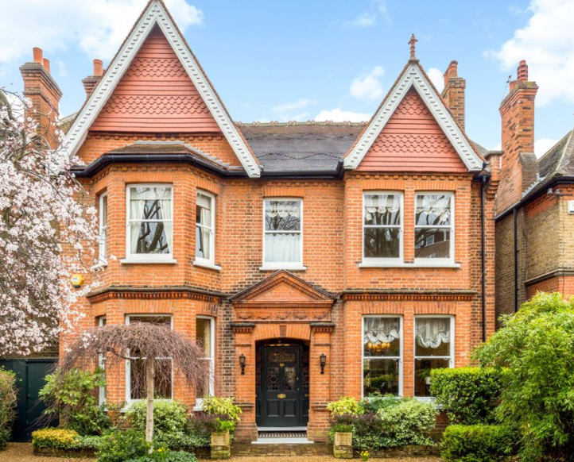
Thank you!
LinkedIn:
https://www.linkedin.com/in/laurenschoener/
Github:
https://github.com/laurenschoener

